Slide 1
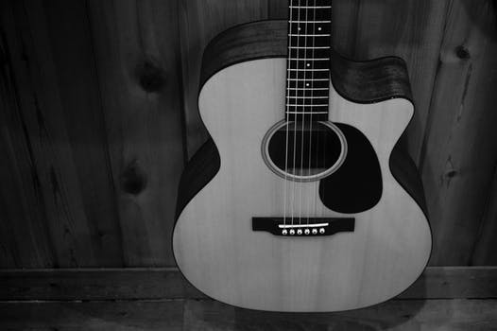
VGA
Datapath
Control
Audio

Slide 2
VGA
Datapath
resetn
is_record
is_play
record_high
reset_address
Control
[5:0]s
[4:0]p
[31:0]note_out
Audio
Sound_mode

Slide 3
Datapath Module
32x64 RAM
coordinate converter
data
q
note_out
[5:0]s
[4:0]p
[31:0] Note
increament address
address
is record
wren
record high
clock

Slide 4
Audio Module
[31:0] note_out
guitar_sound
+
drum_sound
[4:0] frequency
guitar_sound
+
ocean_sound
square_ sound 0
........
30 to 1 mux
square_ sound 29
4 to 1 mux
square_sound
[4:0] frequency
guitar_sound
guitar_ sound 0
........
30 to 1 mux
guitar_ sound 29
Sound-mode

